Slide 1






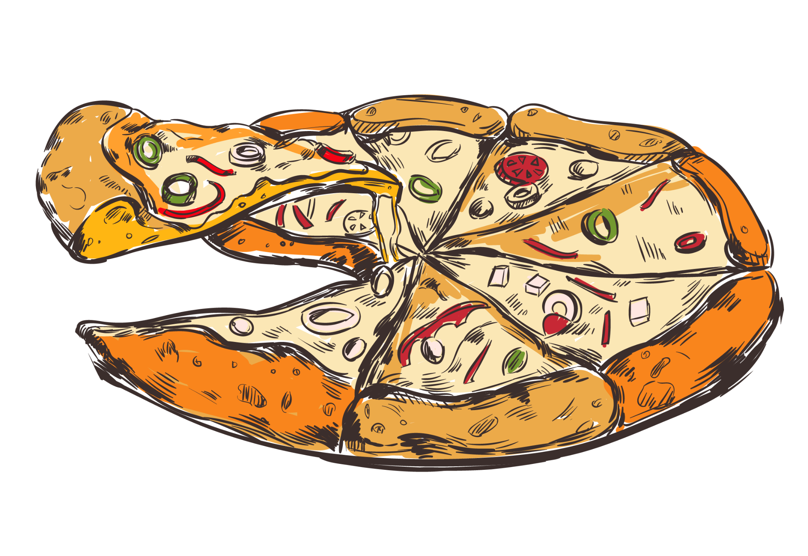

PIZZA SALES
www.slidesgo.es
ANALYSIS
-SHRAVAN BIRAJDAR

Slide 2
TABLE OF CONTENTS
01
02
03
04
INTRODUCTION
CONCEPT & TOPIC
OBJECTIVES
PROBLEM STATEMENT
05
PRACTICAL EXERCISE
06
INSIGHTS & FINDINGS
07
SUMMERY
08
DASHBOARD

Slide 3


INTRODUCTION
The Pizza dataset contain detailed information about pizza orders, including specifics about the pizza variants, quantities, pricing, dates, times, and categorization details.

Slide 4

PIZZA CONCEPTS
Pizza sales analysis evaluates order quantity, price, category, and names across various stages—monthly and daily—to identify key revenue, sales, and quantity factors. This enables pinpointing highest and lowest sales periods, facilitating targeted menu adjustments, pricing strategies, and promotional activities for optimized profitability and customer engagement.

Slide 5

WHAT IS THIS TOPIC ABOUT?
KPI’s
Customer Preferences
Revenue, Order Value, Quantity, etc
Pizza Category, Name, Size, etc
Sales Pattern
Monthly Trend, Category, Pizza Size, etc

Slide 6
OBJECTIVES
Utilized SQL and Power BI to analyze one year of pizza sales data, extracting valuable insights for informed decision-making. The project aimed to identify key trends, customer preferences, and sales patterns, providing a foundation for optimizing inventory, and operational efficiency to drive future growth and profitability.

Slide 7

THIS IS HOW YOU CAN START FINDING INSIGHTS
Do you know what helps you find insights & make your business grow? Lists like these:
Data exploration using MS.SQL server
Data cleaning & ETL
Analyze business problem
Use of DAX function for query solution
Build a proper dashboard on Power BI

Slide 8


PROBLEM STATEMENT
We need to analyze key indicators (KPI’s) for our Pizza sales data to gain insights into our business performance such as:
Total revenue over the year
Average order value
Total pizzas sold
Total Orders
Average Pizzas per order
Apart from this, we need to analyze the data in respect of sellers, trends, most profitable category, preferrable sizes by the customers, total quantity sold over the year.

Slide 9
PRACTICAL
EXERCISE

Slide 10
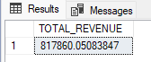
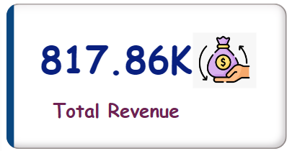
Total Revenue
-SQL
SELECT SUM(total_price) AS TOTAL_REVENUE FROM pizza_sales;
-Power BI
Total Revenue = SUM(pizza_sales[total_price])

Slide 11
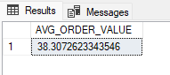
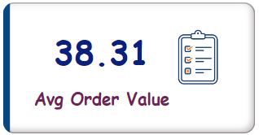
Avg. Order Value
-SQL
SELECT SUM(total_price) / COUNT(DISTINCT order_id) AS AVG_ORDER_VALUE FROM pizza_sales;
-Power BI
Avg Order Value = [Total Revenue] / [Total Orders]

Slide 12
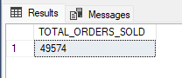
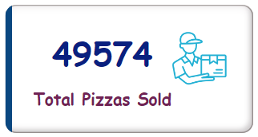
Total Pizzas Sold
-SQL
SELECT SUM(quantity) AS TOTAL_ORDERS_SOLD FROM pizza_sales;
-Power BI
Total Pizzas Sold = SUM(pizza_sales[quantity])

Slide 13
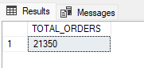
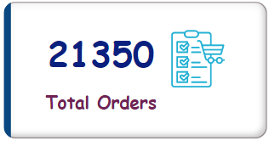
Total Orders
-SQL
SELECT COUNT(DISTINCT order_id) AS TOTAL_ORDERS FROM pizza_sales;
-Power BI
Total Orders = DISTINCTCOUNT(pizza_sales[order_id])

Slide 14
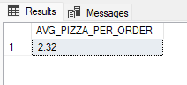
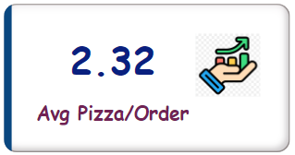
Avg. Pizzas Per Order
-SQL
SELECT CAST (CAST(SUM(quantity) AS DECIMAL(10,2))/ CAST(COUNT(DISTINCT order_id) AS DECIMAL(10,2))AS DECIMAL(10,2)) AS AVG_PIZZA_PER_ORDER FROM pizza_sales;
-Power BI
Avg Pizza/Order = [Total Pizzas Sold] / [Total Orders]

Slide 15
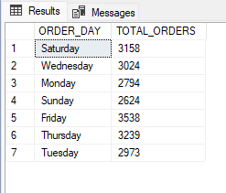
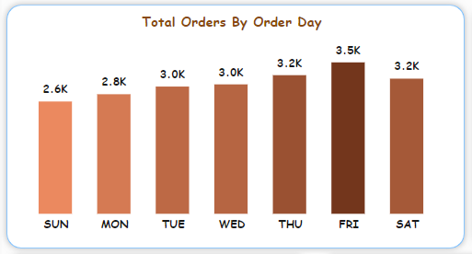
Daily Trend For Total Orders
-SQL
SELECT DATENAME(DW, order_Date) AS ORDER_DAY,
COUNT(DISTINCT order_id) AS TOTAL_ORDERS
FROM pizza_sales
GROUP BY DATENAME(DW, order_date);
-Power BI

Slide 16
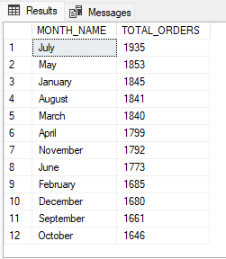
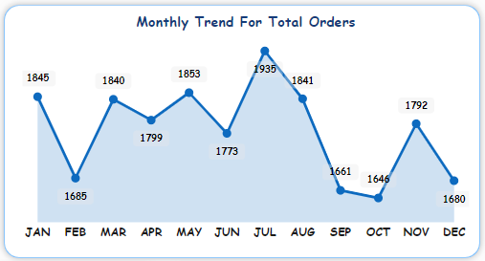
Monthly Trend For Total Orders
-SQL
SELECT DATENAME(MONTH, order_date) AS MONTH_NAME,
COUNT(DISTINCT order_id) AS TOTAL_ORDERS
FROM pizza_sales
GROUP BY DATENAME(MONTH, order_date)
ORDER BY TOTAL_ORDERS DESC;
-Power BI

Slide 17
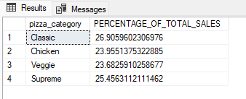
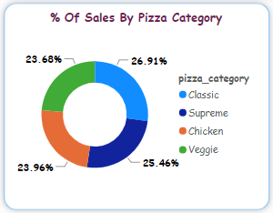
% Of Sales By Pizza Category
-SQL
SELECT pizza_category, SUM(total_price) * 100 / (SELECT SUM(total_price)
FROM pizza_sales) AS PERCENTAGE_OF_TOTAL_SALES
FROM pizza_sales
GROUP BY pizza_category;
-Power BI

Slide 18
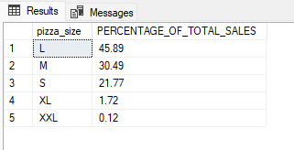
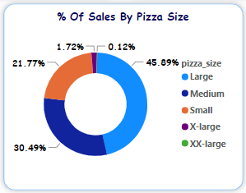
% Of Sales By Pizza Size
-SQL
SELECT pizza_size, CAST (SUM(total_price) * 100 / (SELECT SUM(total_price)
FROM pizza_sales) AS DECIMAL (10,2)) AS PERCENTAGE_OF_TOTAL_SALES
FROM pizza_sales
GROUP BY pizza_size
ORDER BY PERCENTAGE_OF_TOTAL_SALES DESC;
-Power BI

Slide 19
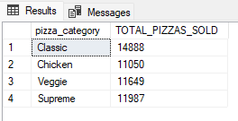
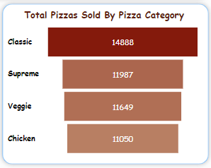
Total Pizzas Sold By Category
-SQL
SELECT pizza_category, SUM(quantity) AS TOTAL_PIZZAS_SOLD
FROM pizza_sales
GROUP BY pizza_category;
-Power BI

Slide 20
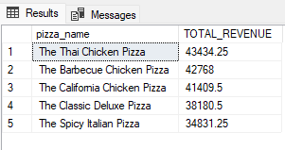
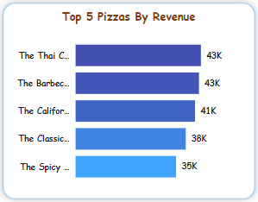
Top 5 Pizzas By Revenue
-SQL
SELECT TOP 5 pizza_name, SUM(total_price) AS TOTAL_REVENUE
FROM pizza_sales
GROUP BY pizza_name
ORDER BY TOTAL_REVENUE DESC;
-Power BI

Slide 21
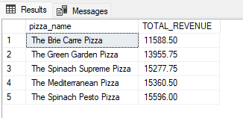
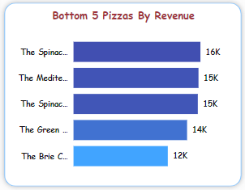
Bottom 5 Pizzas By Revenue
-SQL
SELECT TOP 5 pizza_name, CAST(SUM(total_price) AS DECIMAL (10,2)) AS TOTAL_REVENUE
FROM pizza_sales
GROUP BY pizza_name
ORDER BY TOTAL_REVENUE;
-Power BI

Slide 22
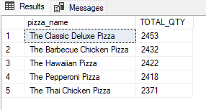
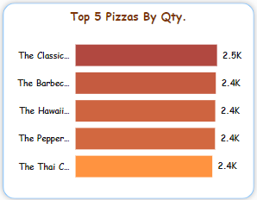
Top 5 Pizza By Quantity
-SQL
SELECT TOP 5 pizza_name, SUM(quantity) AS TOTAL_QTY
FROM pizza_sales
GROUP BY pizza_name
ORDER BY TOTAL_QTY DESC;
-Power BI

Slide 23
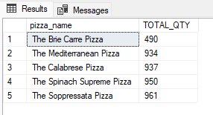
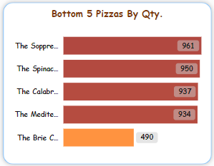
Bottom 5 Pizza By Quantity
-SQL
SELECT TOP 5 pizza_name, SUM(quantity) AS TOTAL_QTY
FROM pizza_sales
GROUP BY pizza_name
ORDER BY TOTAL_QTY;
-Power BI

Slide 24
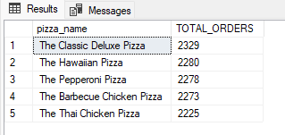
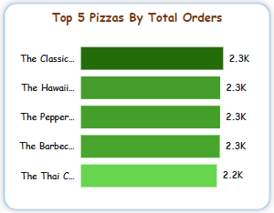
Top 5 Pizza wrt Order
-SQL
SELECT TOP 5 pizza_name, COUNT(DISTINCT order_id) AS TOTAL_ORDERS
FROM pizza_sales
GROUP BY pizza_name
ORDER BY TOTAL_ORDERS DESC;
-Power BI

Slide 25
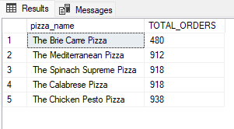
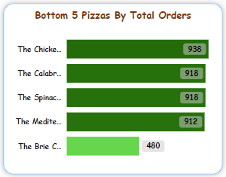
Bottom 5 Pizza wrt Order
-SQL
SELECT TOP 5 pizza_name, COUNT(DISTINCT order_id) AS TOTAL_ORDERS
FROM pizza_sales
GROUP BY pizza_name
ORDER BY TOTAL_ORDERS;
-Power BI

Slide 26
INSIGHTS & FINDINGS
Orders are the highest in numbers on weekends on Friday/Saturday evenings.
By analyzing the monthly trend in terms of orders July and January has the highest orders in numbers.

Slide 27


8,17,860
Total Revenue

Slide 28
ABOUT HIGHEST SALES OF PIZZA
26.9%
45.89%
Highest Sales By Pizza Category
Classic
Highest Sales By Pizza Size
Large

Slide 29
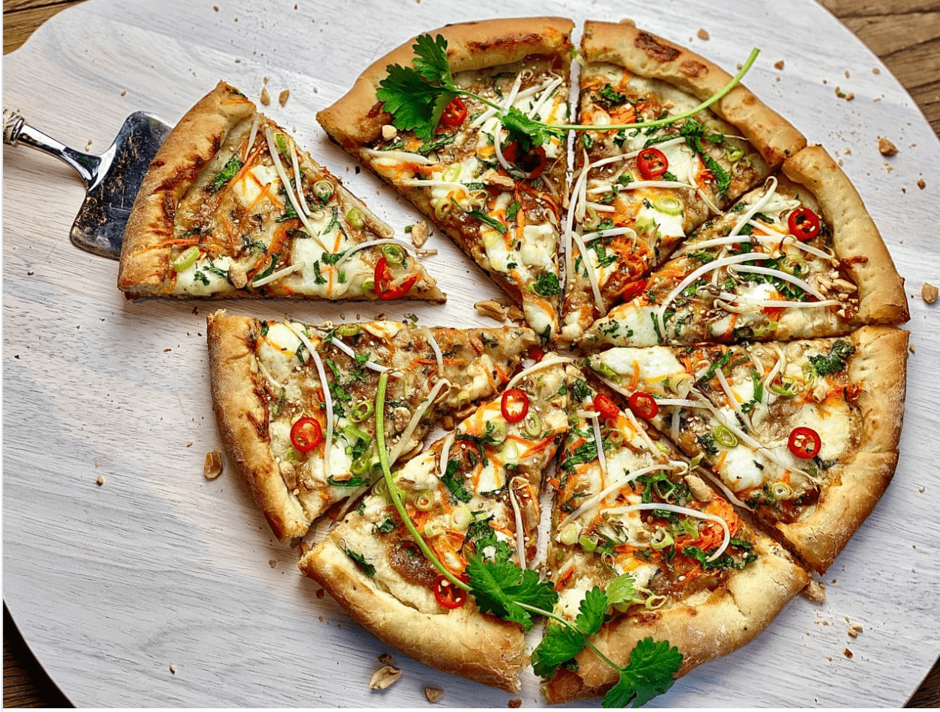
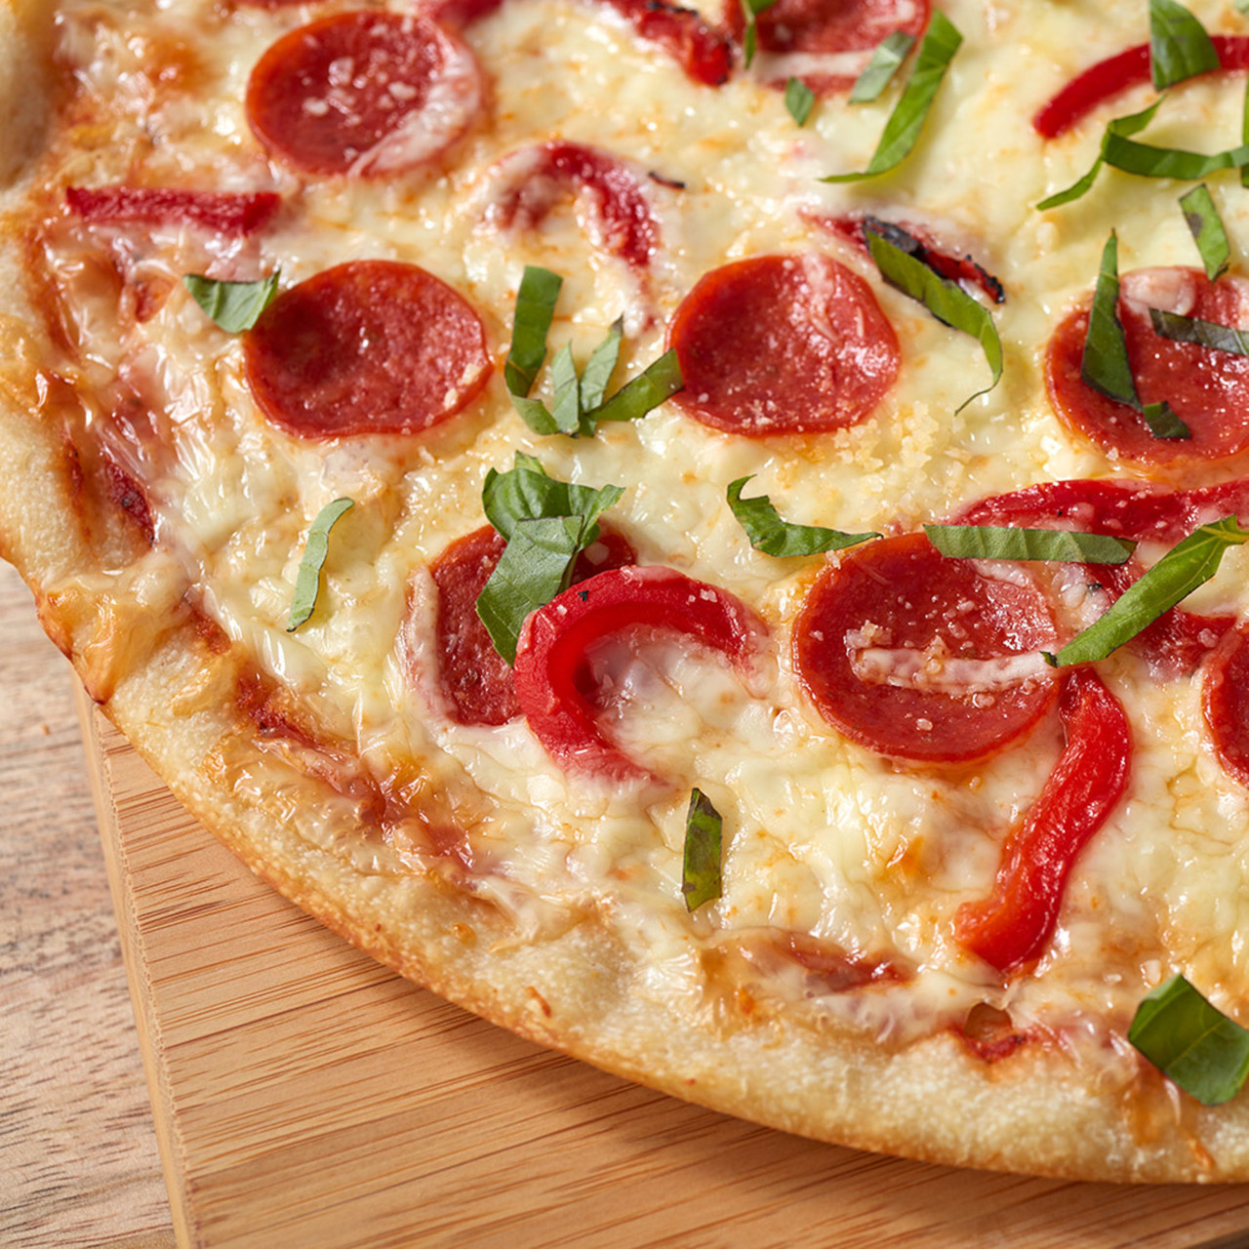
HIGHEST EARNINGS
43434.25
2453
2329
Thai Chicken Pizza
Classic Deluxe Pizza
Classic Deluxe Pizza
Highest earning pizza category by Revenue
Highest earning pizza category by Quantity
Highest earning pizza category by Order

Slide 30
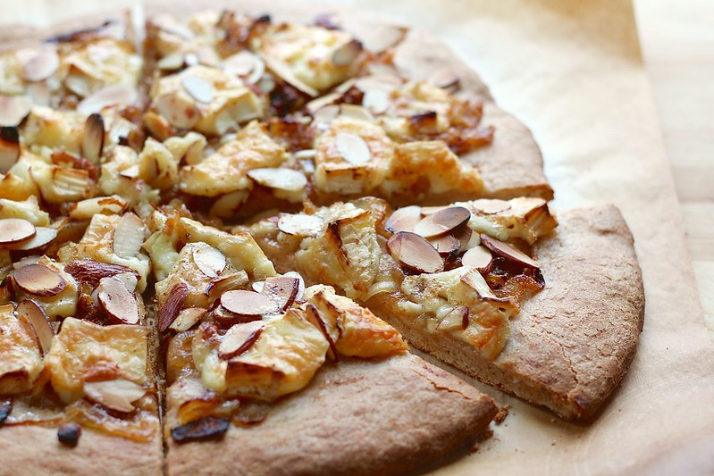
LOWEST EARNINGS
11588.50
490
480
Brie Carre Pizza
Brie Carre Pizza
Brie Carre Pizza
Lowest earning pizza category by Revenue
Lowest earning pizza category by Quantity
Lowest earning pizza category by Order

Slide 31
Total Pizza Orders By Order Day
Friday
Thursday
06
Saturday
Wednesday
05
3538
07
Tuesday
04
3239
3158
Monday
03
3024
Sunday
02
2973
01
2794
2624

Slide 32


Slide 33
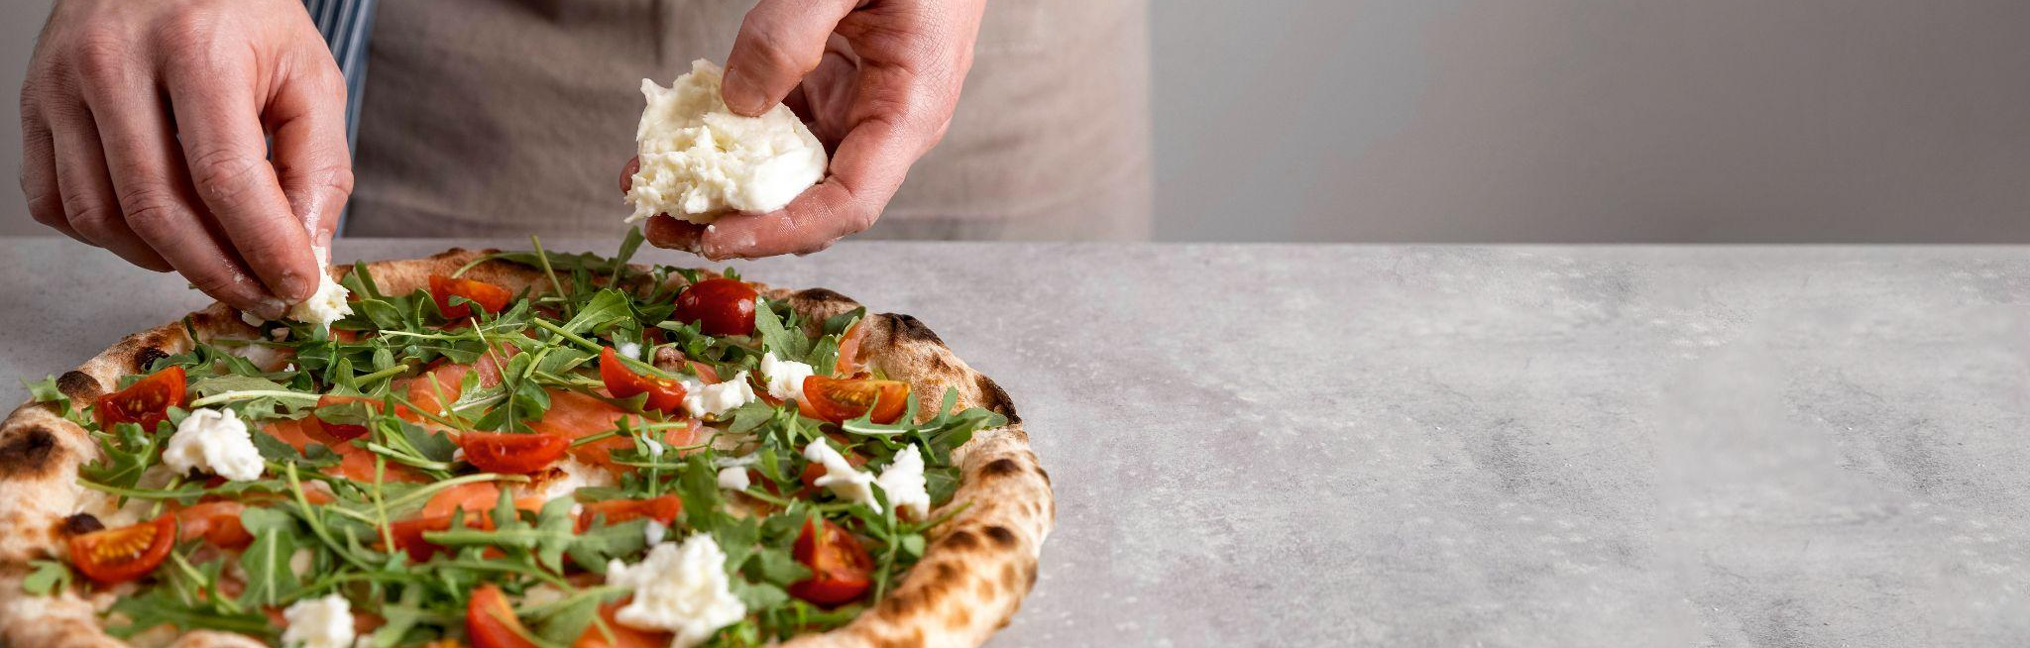
SUMMERY
Pizza sales analysis reveals trends and customer preferences, guiding menu optimization, pricing, and promotions. It helps businesses grow by enhancing profitability, improving customer satisfaction, and informing strategic decisions.

Slide 34
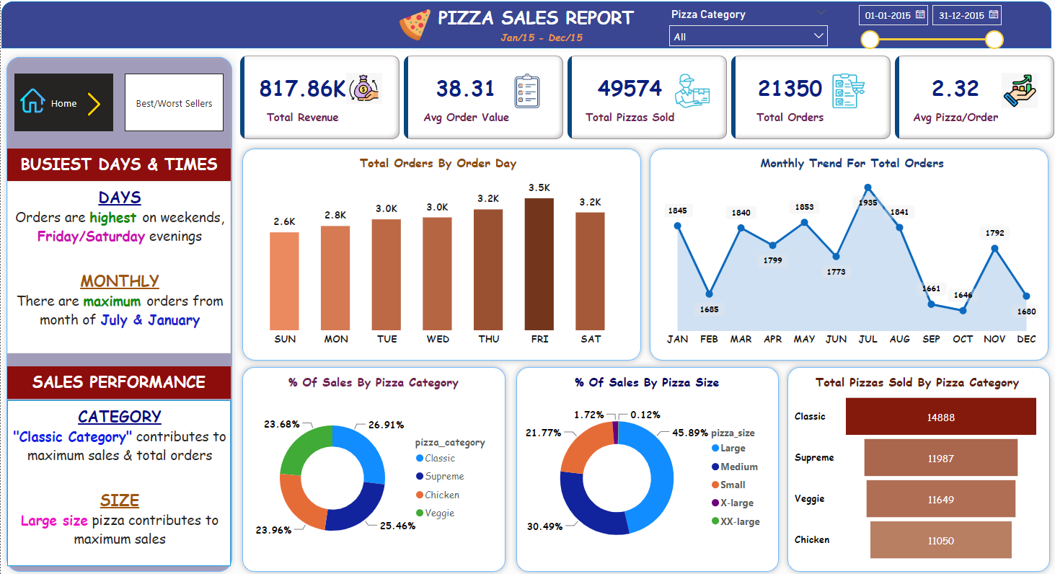
DASHBOARD

Slide 35
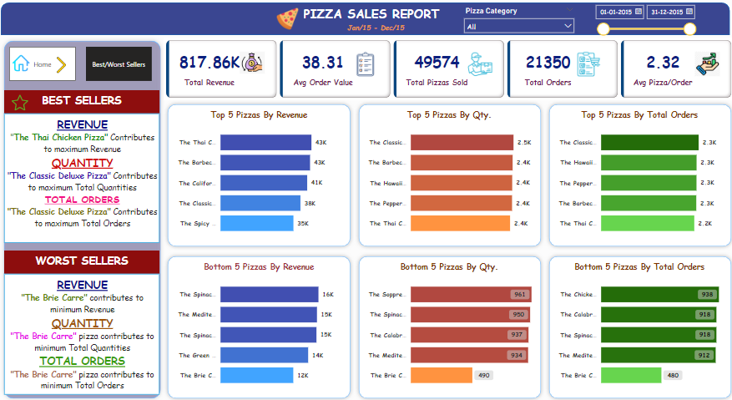
DASHBOARD

Slide 36




THANKS!
Do you have any questions?
shravanbirajdar125@gmail.com
+91 9921226132
LinkedIN

